Slide 1
Insights into Electrotactile Feedback: Parameters and User Preferences
COMPSCI5082P (40 Credits)
Aaron Milne (2466574M)

Slide 2
Introduction
What is electrotactile feedback?
Why is it significant
Visual feedback is not always appropriate.
Benefits over other tactile modalities.
Main objectives of the research.
Explore which electrotactile settings users find comfortable and appropriate.
Define comfortable preset(s) which works in most cases
Further understand user opinions of the topic
Notes:
Novel extension to tactile interaction that utilises a small electrical current to stimulate mechanoreceptors in the skin, triggering perceptions of itchiness and touch.
This renders it a plausible feedback modality.
Significant as visual feedback methods are not always appropriate, such as when working.
Alternatives to visual feedback include other tactile methods, vibrotactile being chief among them.
Electrotactile feedback offers advantages over this as tactors are thin and flexible.
Furthermore, electrotactile signals are more energy efficient than vibrotactile motors, providing an environmental benefit.
Objectives of this research were to explore the range of electrotactile parameter values that users deem suitable when interacting with various widgets.
We would look for clusters in the responses based on widget type.
Then we would attempt to look to quantise the results into a selection of discrete presets that users find suitable across the board.
As a secondary objective, we looked to further understand user opinions of electrotactile feedback.

Slide 3
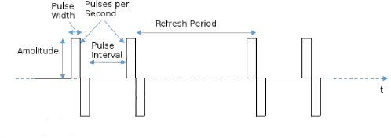
Background
What are the electrotactile signal settings under investigation?
Pulse-width (microseconds)
Frequency (Pulses per Second)
Amplitude (milliamps)
Electrotactile intensity and roughness.
Extending on prior work by Alotaibi et al¹
They found both intensity and roughness affect emotions.
Increasing these leads to an increase of all except valence, which decreases.
Notes:
Pulse-width indicates the duration which each pulse lasts
Frequency determines how many pulses occur in a single second
Amplitude is a measure of how much electrical current, or energy each cue carries.
The amplitude and pulse-width parameters combined represent the intensity of a cue whereas
Frequency has been shown to correlate to electrotactile roughness.
Extends on prior work by Yousef Alotaibi on how signal intensity and roughness affect the emotions of urgency, annoyance, valence and arousal

Slide 4
What we Achieved
Evaluation 1:
Users choose appropriate signal settings from a continuous range.
Evaluation 2:
Five discrete presets were conceived based on the previous results.
Participants choose their favourite from these
Evaluation 3:
Participants completed number and phrase entry tasks.
Times and accuracy was recorded
An extensive questionnaire was presented here to gather qualitative findings
Notes:
Performed three user evaluations to gain insight into electrotactile design
First users had to tune the electrotactile parameters freely from a continuous range until they perceived an appropriate cue based on the widget in which they were interacting.
Secondly, five discrete presets were deterministically chosen from the results and then a new set of users had to choose their favourite from these.
Finally, we asked participants to complete number and phrase entry tasks. They were timed as they completed these and their keystrokes were recorded to compute an accuracy metric.
Participants of all studies were given questionnaires to complete at the end of the experiment, however, the final questionnaire was the most extensive.
It was aimed to gather the most relevant opinions as users of this stage were performing more realistic tasks.

Slide 5
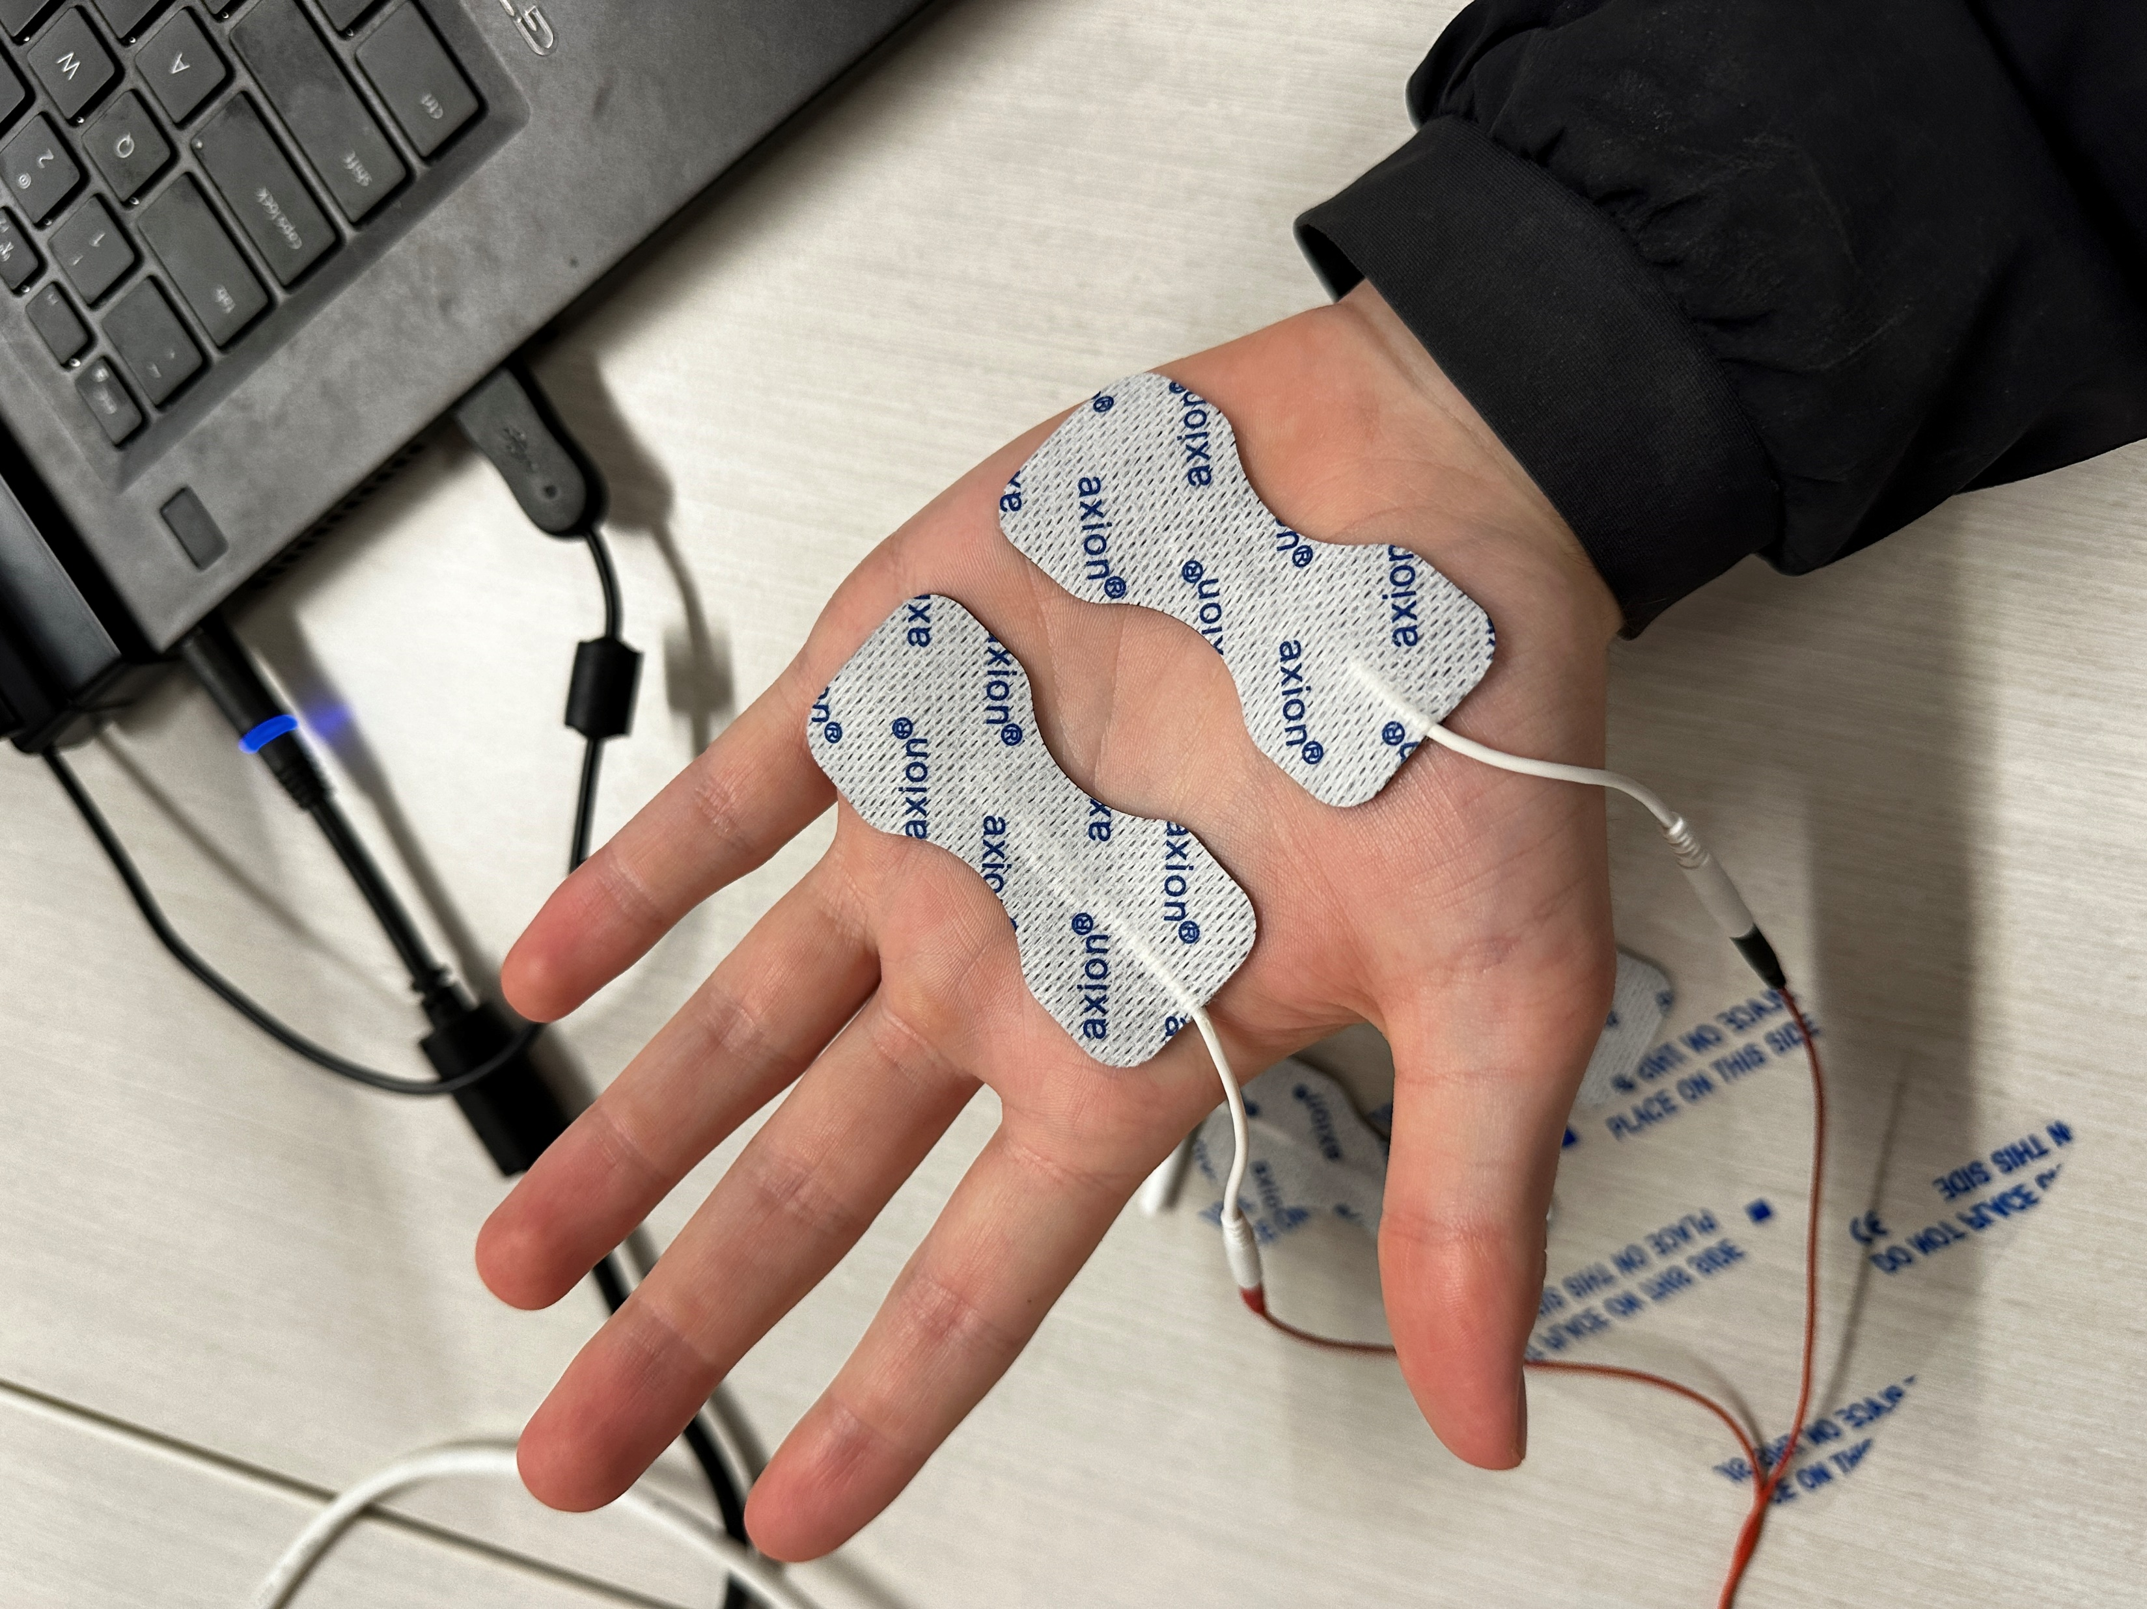
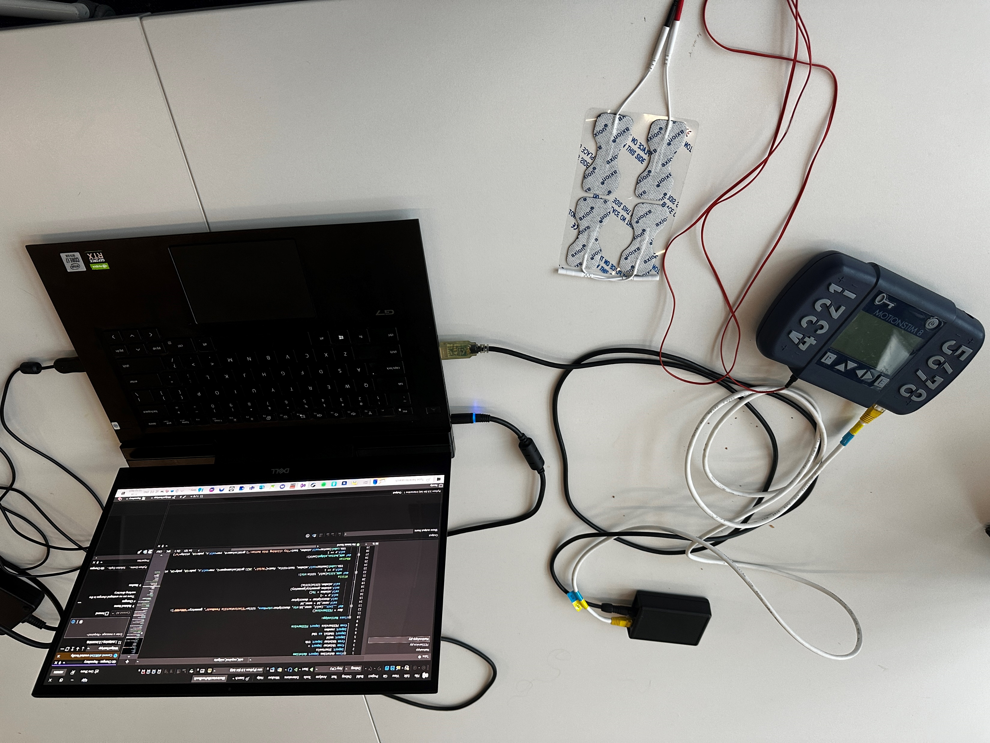
Equipment used
MOTIONSTIM 8 Functional electrical stimulator (FES) device.
Laptop to run the application code.
USB mouse to interact with the widgets.
Self-adhesive electrodes.
These were attached to participants’ hands as shown.
Notes:
We used the motionstim FES device which was pre-modified to work with driver code obtained from Alotaibi Yousef’s former research.
This driver code was modified to work with the custom widget application we developed during this research.
A demo of this code is provided at the end of this presentation.
A USB mouse was also used by participants to interact with clickable widgets.
Axion self-adhesive electrodes were attached to participants’ hands as shown and provided the contact point for the electrotactile cue.

Slide 6
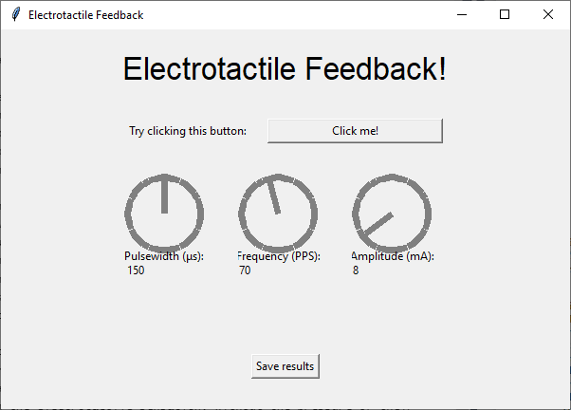
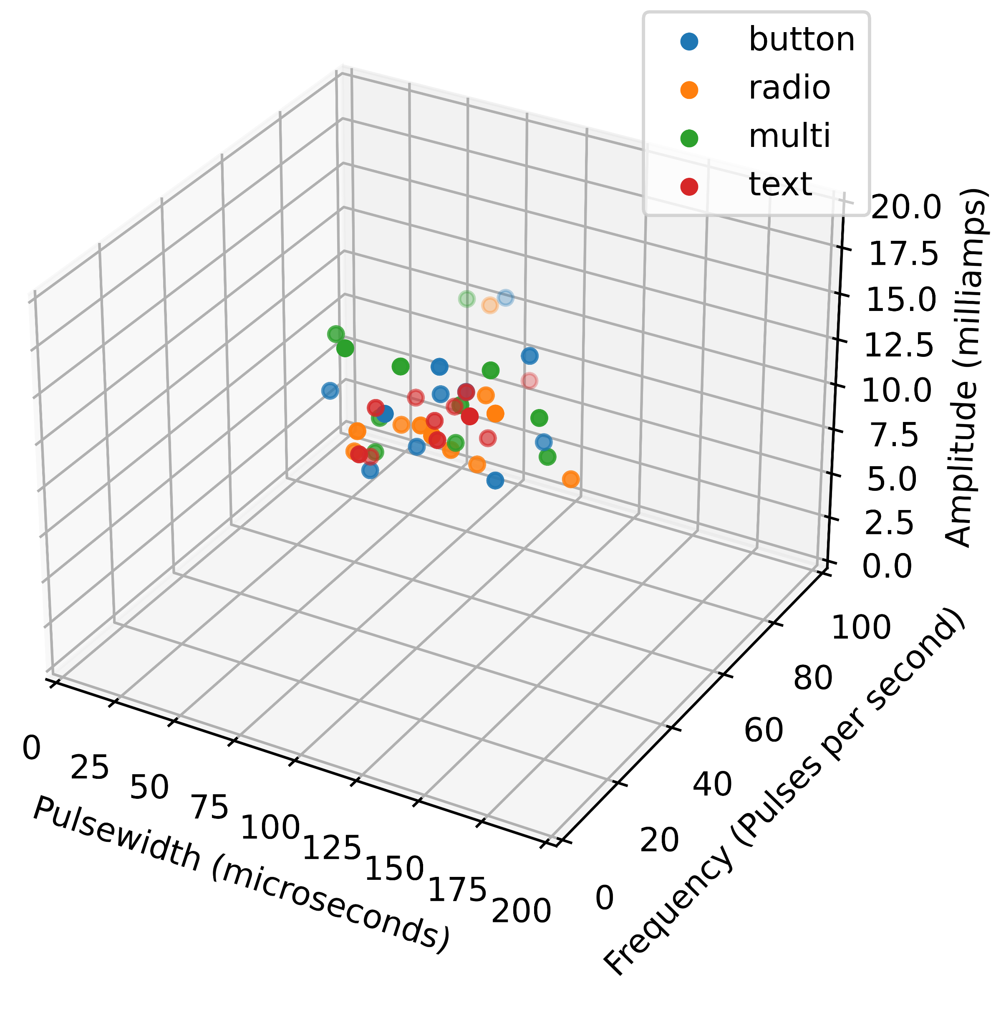
Evaluation 1 – Continuous Parameters
Four widget types were shown to users.
Button
Radio
Multi-select
Text input
Dials shown on the GUI allowed users to tune individual settings to an appropriate level.
A cluster appeared in the results indicating an optimum range of values for each setting.
pulse-width: 60μs-130μs, frequency: 30PPS-65PPS and amplitude: 9mA-15mA
No evidence of clusters based on widget type.
Notes:
Four widget types were presented to users button, radio, multi, text and users were instructed to interact with these.
Doing so provided electrotactile feedback cues with the settings as indicated by the value of the dials.
They were to turn the dials until the signal they experienced felt appropriate for the widget they were interacting with.
A single cluster appeared in the results within which approx. 69% of the average points for each widget lay.
No evidence was obtained to prove that widget type had any correlation with electrotactile signal parameters.

Slide 7
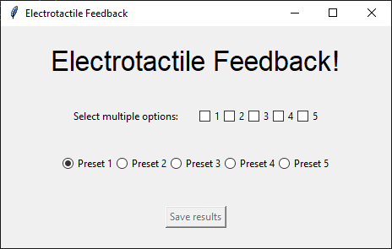
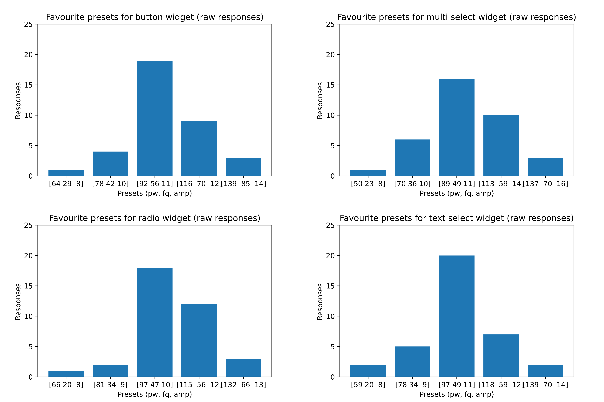
Evaluation 2 – Discrete Presets
Five discrete presets conceived for each widget.
The same widget types were shown to users as before.
Users were to choose their favourite from the five presets across each widget.
Results prove that the median strength preset (3) was the most popular, being selected up to 55% of the time.
Presets 2 and 4 were also popular choices.
Notes:
We deterministically selected five discrete presets, of increasing strength, from the results of the prior evaluation.
The same widgets as before were shown to subjects to interact with, this time they had to try all five presets before deciding on a favourite.
The results indicate that the median strengthed preset, preset 3 – which lay roughly central in the optimal cluster we obtained before – performed best for all widget types
It was selected 55% of the time for text input widgets.
Presets 2 and 4 were popular choices among those who found the median slightly too strong or weak. These were chosen up to 1/3 of times and 16.7% of times respectively (widget dependant).
These 3 presets combined form three inclusive options for tactile design.

Slide 8
Evaluation 3 – Phrase and Number Entry
Users performed a number entry task by clicking numbers on a keypad on the GUI.
They then had to enter randomly selected phrases into text entry widgets.
Each task was completed with and without electrotactile feedback.
Times and keystrokes were recorded.
Results show an increase in efficiency and minimal change to accuracy during these tasks.
Qualitative analysis showed that sentiment improved during this evaluation – since a refined setting was used.
Notes:
Users first entered six-digit numbers into the app by using the mouse to click the keypad shown on the user interface.
They then had to use the keyboard to type random phrases into the text entry widget shown on the screen.
Each task was completed 10 ten times without non-visual feedback and then 10 times with electrotactile feedback, at the strength of the best performing preset - for button and text widgets - from evaluation 2.
Keystrokes and time taken to complete tasks were recorded.
Our results show an average increase in efficiency by 8.94% during the number entry task and 6.23% for the phrase entry with
negligible change in accuracy for the former and a slight increase of 4.16% for the phrase entry.

Slide 9
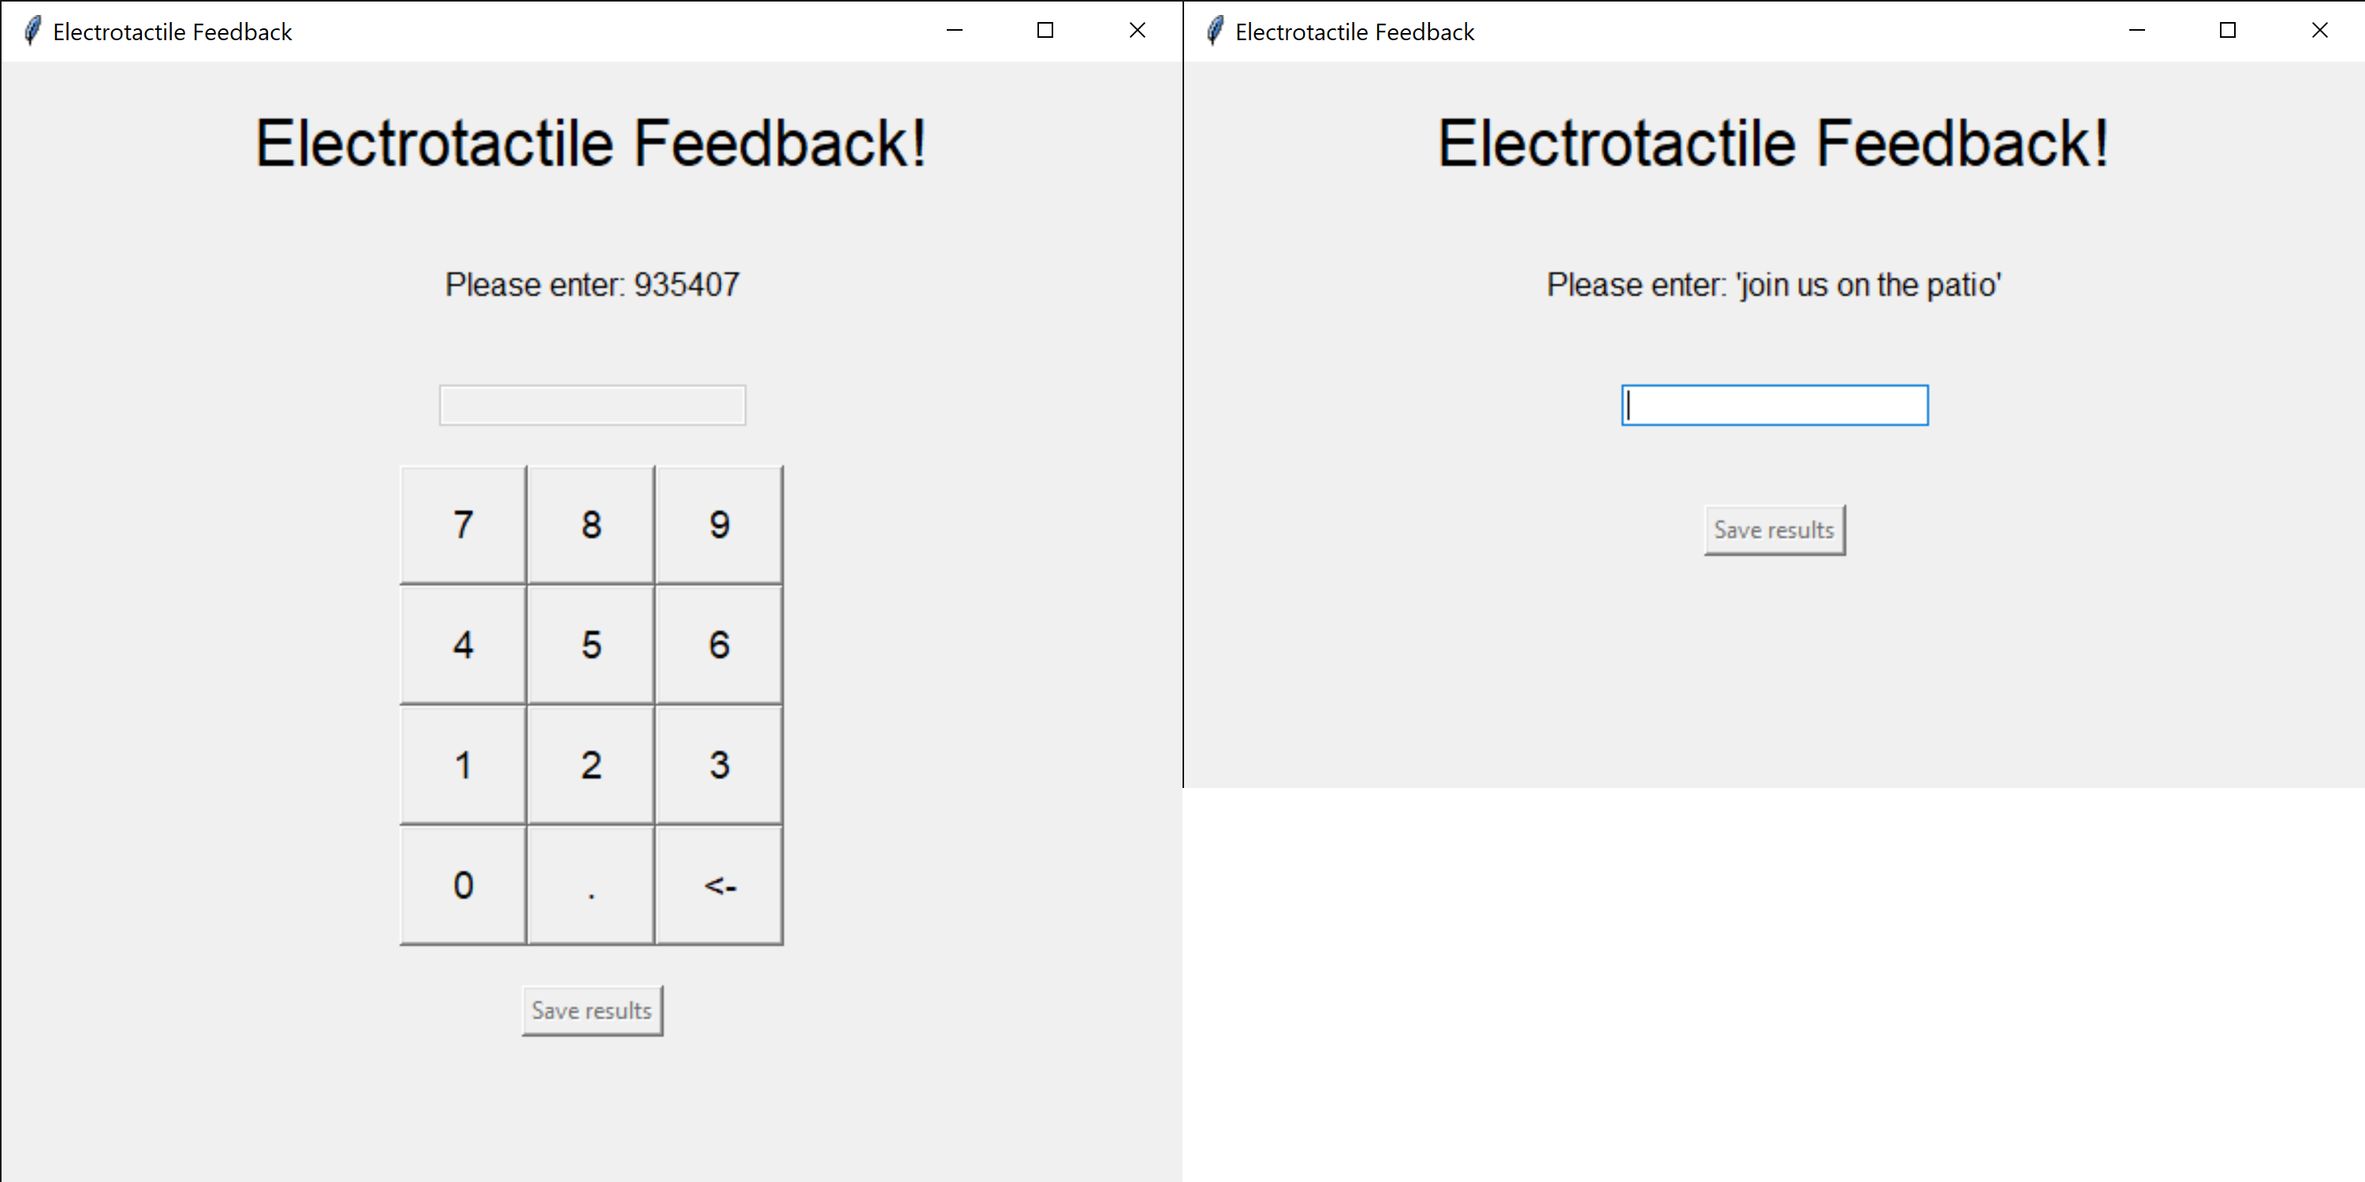
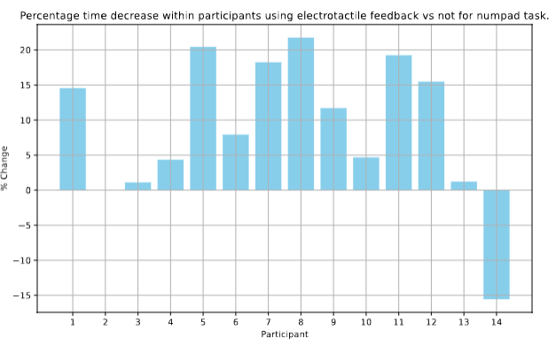
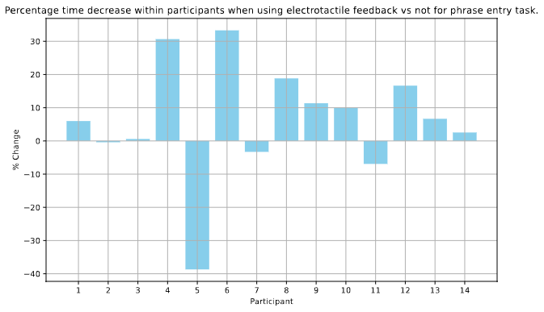
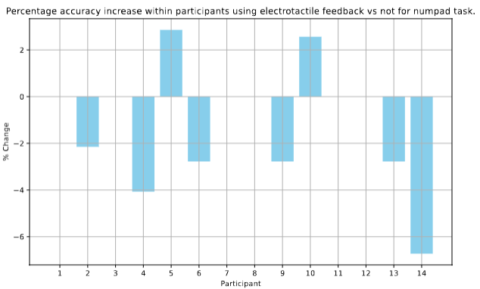
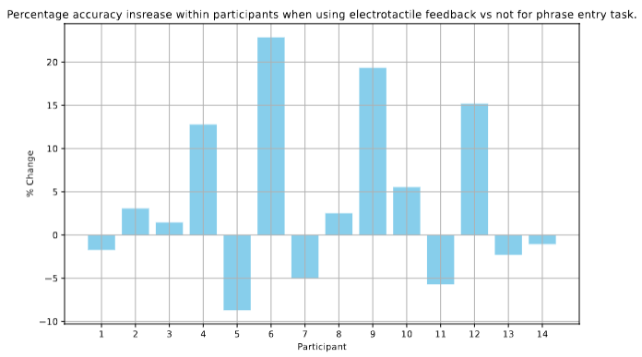

Slide 10
Conclusions
Cluster was obtained where 69% of average responses lay.
pulse-width: 60μs-130μs, frequency: 30PPS-65PPS and amplitude: 9mA-15mA
Preset 3 was the most popular, being selected up to 55% of the time during evaluation two.
Presets 2 and 4 were chosen with the second and third most frequency – forming three appropriate preset options.
Additional fine-tuning and refinement required.
Despite this sentiment in responses improved in evaluation three
Some level of customization will be required in future designs.
Notes:
To conclude, we found a cluster of values where 69% of averaged points lay,
A preset lying close to the centre of this cluster that performed well in practice, with it being the most opted-for preset across all four widget types.
Two additional presets that also proved popular, thus, forming three foundational presets for electrotactile signals that are inclusive.
We also noted the need for further fine-tuning and refinement, as well as some amount of customisation being required in future designs.
Despite this we did notice an improvement in sentiment based on questionnaires collected.

Slide 11
Live Code Demo
How to run the code straight from GitHub.²
Interaction with the app.
Result files being saved.
Changing modes.

